Slide 1
Predicting health insurance costs using support vector regression
Prepared by the student: Albara khalid almaseidiyen
Supervised by: Dr. mohammad abdallah almseidin

Slide 2
Project Overview and Objective
Overview: The project aims to apply one of the machine learning methods to a set of real-world data, and the method chosen is regression with support victor machine algorithm
Objective: Apply a machine learning model on a dataset containing health insurance costs for a group of individuals in the United States using, along with a set of personal data related to these individuals such as gender and number of children.

Slide 3
Attributes: age, sex(gender), bmi(Body mass index), children, smoker, region, charges(insurance cost)
Number of rows and: 1338
Number of Columns: 7
Source: Kaggle
Dataset Description
Sample of dataset

Slide 4
Methods and algorithms used
1-)Support Vector Machine (SVM):The SVM is a supervised machine learning algorithm for classification and regression problems. It works by finding an optimum hyperplane that separates the classes with the maximum margin between the data. In the case of nonlinear data, it works effectively by mapping into a higher dimension with the help of kernel functions.
2-)Regression: The regression is a statistical method that models a dependent variable (target) with one or more independent variables' relationships, known as predictors. It aims to predict the dependent variable's value using the predictors by minimizing the difference between the observed and predicted values of the dependent variable.
3-)Polynomial Regression: is a form of regression analysis in which the relationship between the dependent and independent variables is modeled by an nth-degree polynomial. It is an extended version of linear regression wherein a curve is fitted through the data. Therefore, it is useful to capture the non-linear relationship.

Slide 5
Methods and algorithms used(why?)
-)Support Vector Machine (SVM)
1. Flexibility with Kernels:
- SVM supports a variety of kernels (e.g., linear, polynomial, radial basis function), making it adaptable to both linear and non-linear relationships.
2. Effective for High-Dimensional Data:.
- SVM works well in high-dimensional spaces and when the number of dimensions exceeds the number of data points.
3. Robust to Overfitting:
- By maximizing the margin (distance between data points and the decision boundary), SVM minimizes overfitting, especially when using the appropriate regularization parameter \(C\).
4. Support for Regression:
- SVM regression (SVR) uses an (epsilon)-insensitive tube to focus on predictions within a specified tolerance level, making it ideal for precise, robust predictions.

Slide 6
Methods and algorithms used(why?)
Regression:
1. Simplicity and Interpretability:
- Regression models are straightforward to understand and explain, making them ideal for scenarios where model interpretability is essential.
2. Versatility:
- Regression can model relationships between dependent and independent variables, whether linear or non-linear.
3. Predictive Power:
- Regression focuses on predicting continuous outcomes, making it suitable for tasks like insurance cost estimation or price prediction.
4. Baseline Model:
- Regression often serves as a baseline model to compare more complex algorithms' performance.

Slide 7
Methods and algorithms used(why?)
Polynomial Regression
1. Non-Linear Relationships:
- Polynomial regression is used when data exhibits a non-linear trend that cannot be captured by simple linear regression.
2. Feature Flexibility:
- By including polynomial terms, the model can approximate curves and bends in the data, improving fit.
3. Ease of Implementation:
- It is relatively simple to implement, requiring minimal additional preprocessing compared to linear regression.
4. Balances Complexity:
- Polynomial regression offers a middle ground between linear models (too simple) and high-complexity models (e.g., deep learning).

Slide 8
Methods and algorithms used(why?)
Why Use Polynomial Kernel in SVR?
1. Captures Non-Linear Patterns:
- The polynomial kernel enables SVM to model non-linear relationships without explicitly transforming the data.
2. Smooth Fits:
- By tuning the degree of the polynomial, you can control the complexity of the model, ensuring it fits the data without overfitting.
3. Handles Multi-Dimensional Data:
- Polynomial kernels are effective in scenarios with complex, multi-dimensional interactions.

Slide 9
Data Preprocessing Techniques
Techniques:
1) transform categorical data into numerical
2) Feature scaling
3) Splitting data into training and testing sets
4)Scaled the dataset features values

Slide 10
Data Preprocessing Techniques
Techniques:
1) transform categorical data into numerical
2) Feature scaling
3) Splitting data into training and testing sets
4)Scaled the dataset features values

Slide 11
Algorithm Implementation
1-)Define the model kernel and hyperparameters:
model = SVR(kernel='poly',C=80,epsilon=0.001,gamma=0.6)
C=80: Controls the trade-off between achieving a low error on the training set and minimizing the model complexity.
epsilon=0.001: Specifies the margin of tolerance for errors.
gamma=0.6: Determines the influence of a single training example.
2-)training the model:
model.fit(X_train, y_train)
3-) Cross-Validation:
scores = cross_val_score(model, X_train,y_train, cv=5)
4-) Make predictions on the test set
y_pred =model.predict(X_test)

Slide 12
Results
Results: Performance metrics (e.g., R², MSE)
Mse: Mean Squared Error: 21724489.234933894 .
Mae: Mean Absolute Error: 1867.7518039005386 .
R²:R-squared: 0.8600665588299183 .
Cross-Validation Scores in R² :
[0.80373797, 0.86677275 ,0.78126325 ,0.73540017 ,0.82574013]

Slide 13
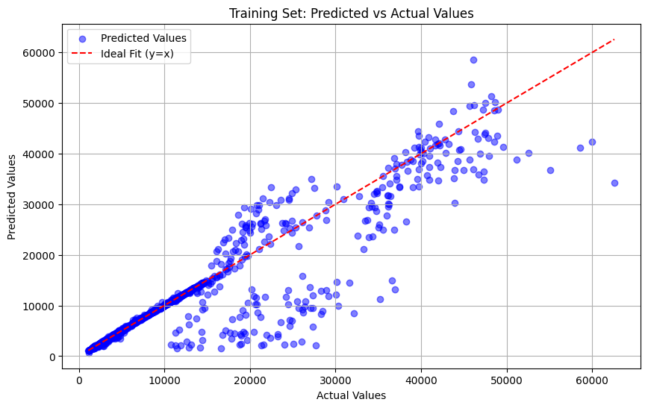
Performance Evaluation
The graph below show the distance between the predicted values point in training set and the ideal fit line

Slide 14
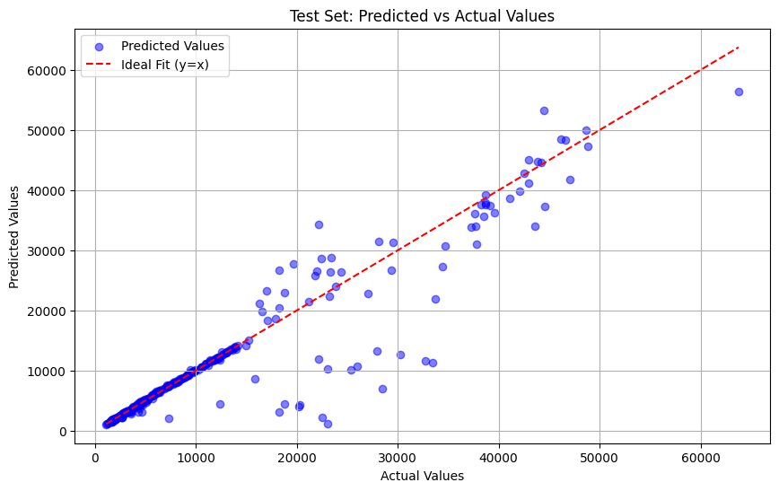
Performance Evaluation
The graph below show the distance between the predicted values point in testing set and the ideal fit line

Slide 15
Summary and Conclusion
By working on this project, we can conclude the following points:
1-) Support Vector Machine algorithm has high potential and flexibility due to their use of kernels, allowing them to handle linear (linear kernel) and non-linear problems (polynomial, radial basis function, or sigmoid kernels). .
2-) The advantage of polynomial regression is that it fits the data very well without overfitting

